Slide 1
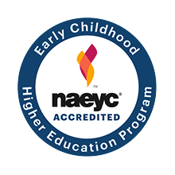
Virginia Peninsula Community College Early Childhood Development AAS Degree
2018-2019

Slide 2
Children Need You!
Did you know that 90% of brain development happens before age 5? Is your goal to make a difference in the lives of young children and their families? Ensure a good start in life?
Do you want to work with or teach young children aged birth to 8?
Virginia Peninsula Early Childhood Development program prepares students to provide high-quality early care and education for children up to eight years old.
For more information, visit https://www.tncc.edu/programs/early-childhood-development-associate-degree

Slide 3
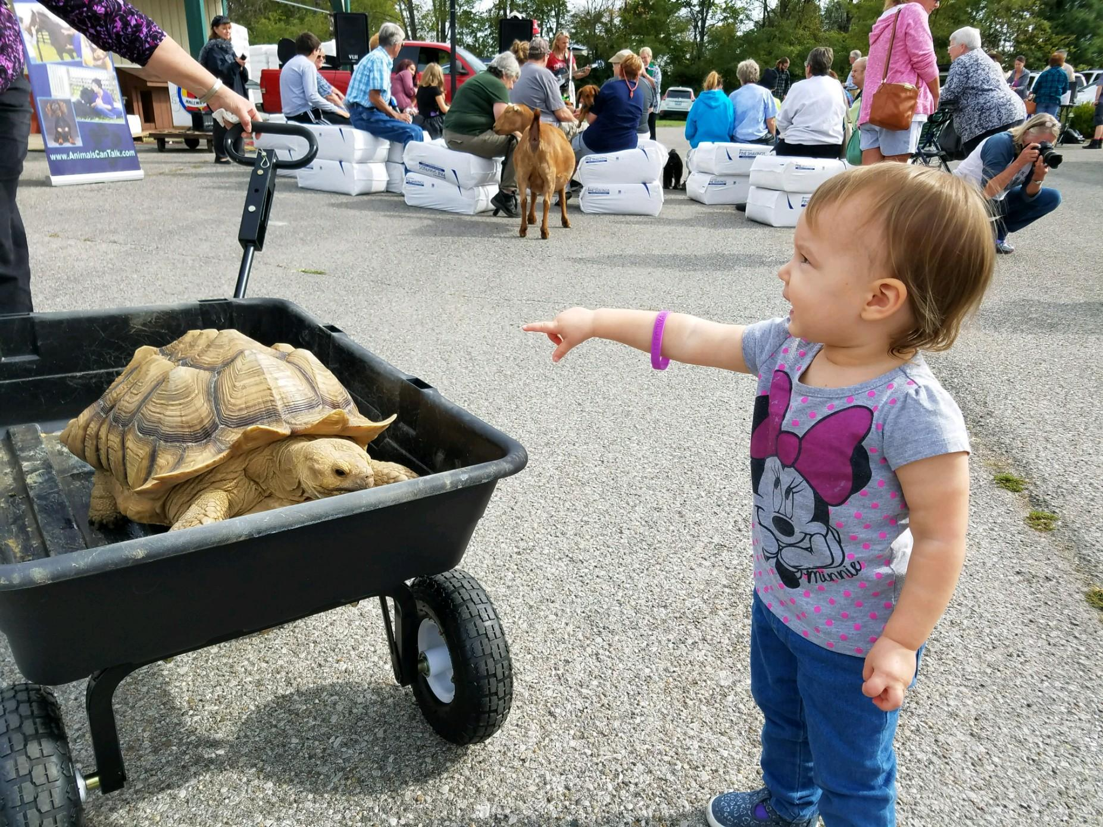
Additional Information
We offer courses that lead to stackable credentials – from career studies to one year certificate to a two-year AAS degree in early childhood. We offer courses that lead to stackable credentials – from career studies to one year certificate to a two-year AAS degree in early childhood development.
Classes offered day, nights, weekends and online. Day classes are scheduled either Monday/Wednesday or Tuesday/Thursday. No day classes on Friday.
There are several scholarships available for early childhood students helping to keep tuition and book costs to a minimum
What can you do once you finish your early childhood degree?
Students who complete the AAS degree are also eligible for transfer into select teacher education programs at 4-year higher education universities designed for licensure pre-k-3rd grade.

Slide 4
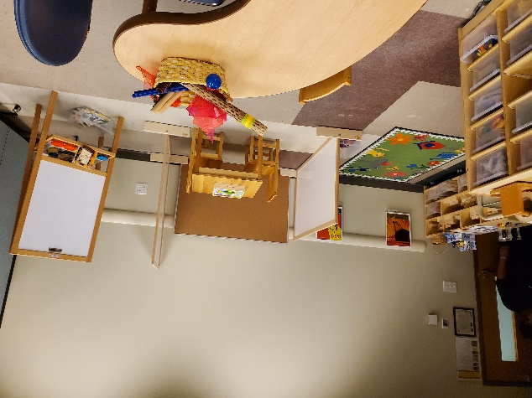
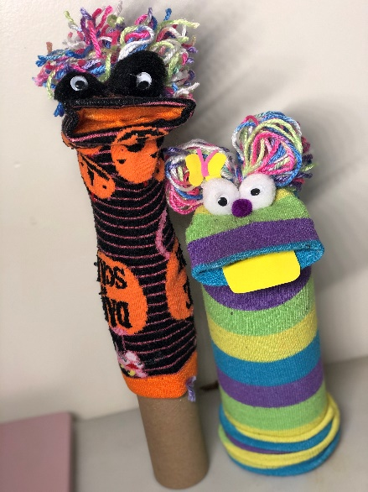
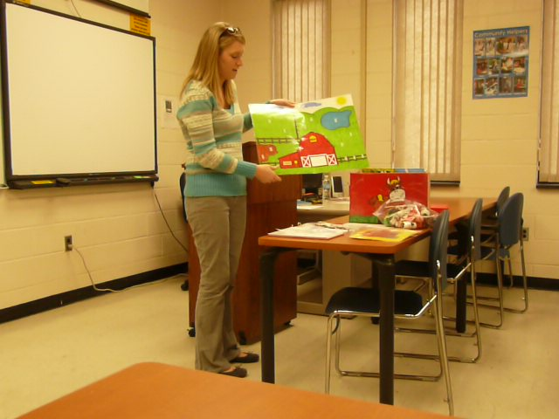
For more information on the Early Childhood Development Program use the contact information below
PSAHHS Advising Team
Hampton Campus,
Hastings, Suite 323
(757) 825-2993
Teresa Frazier
Program Head
Early Childhood Development
fraziert@tncc.edu
757-825-3550
Historic Triangle campus,
Seth Fisher
757-825-258-6529

